Slide 1
CMSC201
Computer Science I for Majors
Lecture 22 – Binary (and More)

Slide 2
Last Class We Covered
Dictionaries
  Creating
  Accessing
  Manipulating
  Methods
Dictionaries vs Lists

Slide 3
Any Questions from Last Time?

Slide 4
Today’s Objectives
To understand how data is represented
and stored in memory
  Binary numbers
    Floating point errors
  ASCII values
To see the benefits of short circuit evaluation
To learn about other programming languages

Slide 5
Binary Numbers

Slide 6
Binary Numbers
Computers store all information (code, text, images, sound,) as a binary representation
  “Binary” means only two parts: 0 and 1
Specific formats for each file help the computer know what type of item/object it is
But why use binary?

Slide 7
Decimal vs Binary
Why do we use decimal numbers?
  Ones, tens, hundreds, thousands, etc.
But computers don’t have fingers…
  What do they have instead?
They only have two states: “on” and “off”
Notes:
We use decimal because we have 10 fingers, or 10 different things we can use to count with.

Slide 8
Decimal Example
How do we represent a number like 50,932?
2 x 10⁰ = 2
3 x 10¹ = 30
9 x 10² = 900
0 x 10³ = 0000
5 x 10⁴ = 50000
------
Total: 50932
ten thousands
thousands
hundreds
tens
ones
5
0
9
3
2
10⁴
10³
10²
10¹
10⁰
Decimal uses 10 digits, so…

Slide 9
Another Decimal Example
6 | 7 | 4 | 9 | 3
10⁴ | 10³ | 10² | 10¹ | 10⁰
10000 | 1000 | 100 | 10 | 1
60000 | 7000 | 400 | 90 | 3
60000+7000+400+90+3 = 67493

Slide 10
Binary Example
Let’s do the same with 10110 in binary
0 x 2⁰ = 0
1 x 2¹ = 2
1 x 2² = 4
0 x 2³ = 0
1 x 2⁴ = 16
--
Total: 22
sixteens
eights
fours
twos
ones
1
0
1
1
0
2⁴
2³
2²
2¹
2⁰
Binary uses 2 digits, so our base isn’t 10, but…

Slide 11
Binary to Decimal Conversion
Step 1: Draw Conversion Box
Step 2: Enter Binary Number
Step 3: Multiply
Step 4: Add
2⁹ | 2⁸ | 2⁷ | 2⁶ | 2⁵ | 2⁴ | 2³ | 2² | 2¹ | 2⁰
512 | 256 | 128 | 64 | 32 | 16 | 8 | 4 | 2 | 1
1 | 0 | 1 | 0 | 0 | 0 | 1 | 1 | 0 | 1
512 | 0 | 128 | 0 | 0 | 0 | 8 | 4 | 0 | 1
128 + 0 + 0 + 0 + 8 + 4 + 0 + 1 = 141

Slide 12
Exercise: Converting From Binary
What are the decimals equivalents of…
  101
  1111
  100000
  101010
  0010 1010
  1000 0000
Longer binary numbers are often broken into blocks of four digits for the sake of readability

Slide 13
Exercise: Converting From Binary
What are the decimals equivalents of…
  101 = 4+0+1 = 5
  1111 = 8+4+2+1 = 15
  100000 = 32+0+0+0+0+0 = 32
  101010 = 32+0+8+0+2+0 = 42
  0010 1010 = 32+0+8+0+2+0 = 42
  1000 0000 = 128+...+0+0 = 128

Slide 14
Decimal to Binary Conversion
Step 1: Draw Conversion Box
Step 2: Compare decimal to highest binary value
Step 3: If binary value is smaller, put a 1 there and
subtract the value from the decimal number
Step 4: Repeat until 0
Convert 163 to binary
2⁹ | 2⁸ | 2⁷ | 2⁶ | 2⁵ | 2⁴ | 2³ | 2² | 2¹ | 2⁰
512 | 256 | 128 | 64 | 32 | 16 | 8 | 4 | 2 | 1
1 | 0
1 | 0 | 0 | 0
1
1
163-128 = 35
35-32 = 3
3-2=1
1-1=0

Slide 15
Converting to Binary
What are the binary equivalents of…
  9
  27
  68
  216
  255

Slide 16
Converting to Binary
What are the binary equivalents of…
  9 = 1001 (or 8+1)
  27 = 0001 1011 (or 16+8+2+1)
  68 = 0100 0100 (or 64+4)
  216 = 1101 1000
  (or 128+64+16+8)
  255 = 1111 1111
  (or 128+64+32+16+8+4+2+1)

Slide 17
Binary Tips and Tricks
Some “sanity checking” rules for conversions:
Binary can only be 1 or 0
  If you get “2” of something, it’s wrong
Odd numbers must have a 1 in the ones column
  Why? (And what’s the rule for even numbers?)
Each column’s value is the sum of all of the previous columns (to the right) plus one
  In decimal, what column comes after 999?

Slide 18
Floating Point Errors

Slide 19
Division: Floats and Integers
Floats (decimals) and integers (whole numbers) behave in two different ways in Python
  And in many other programming languages
Biggest difference is how division works
  Python 3 automatically performs decimal division
    Have to explicitly call integer division
  Floats also automatically perform decimal division

Slide 20
Division Examples
What do the following expressions evaluate to?
  4 / 3
  4 // 3
  4 // 3.0
  8 / 3
  8 / 2
  5 / 7
  5 // 7
= 1.3333333333333333
= 1
= 1.0
= 2.6666666666666667
= 4.0
= 0.7142857142857143
= 0

Slide 21
Floating Point Errors
In base 10, some numbers are approximated:
  0.66666666666666666666666667…
  3.14159265358979323846264338328…
The same is true for base 2
  0.00011001100110011001100… (0.1 in base 10)
This leads to rounding errors with floats
  General rule: Don’t compare floats for equality after you’ve done division on them!

Slide 22
ASCII Values

Slide 23
ASCII Values
ASCII is how text is represented in computers
  Just like binary is how numbers are represented
In ASCII, every character has a unique, individual numerical code
  Lowercase and uppercase characters are separate
  Codes go from 0 to 127
    Why 127?

Slide 24
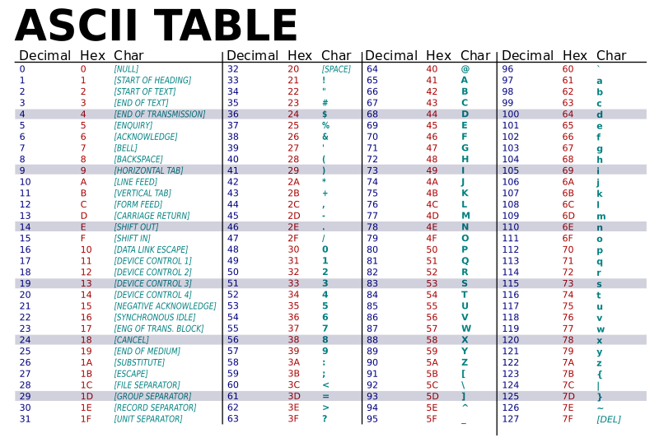
Image from wikimedia.org
Notes:
https://commons.wikimedia.org/wiki/File:ASCII-Table-wide.svg

Slide 25
“control” characters
uppercase letters
symbols & numbers
lowercase letters
Image from wikimedia.org
Notes:
https://commons.wikimedia.org/wiki/File:ASCII-Table-wide.svg

Slide 26

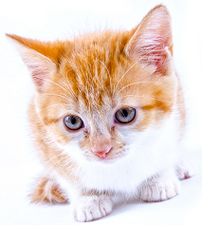
Comparing Strings
The values of the ASCII characters are used when comparing strings together
  Which can lead to some “weird” results
  >>> "cat" < "dog"
  True
  >>> "cat" < "Dog"
  False
  >>> "DOG" < "dog"
  True
<
Images from publicdomainpictures.net
Notes:
http://www.publicdomainpictures.net/view-image.php?image=87454&picture=cat
http://www.publicdomainpictures.net/view-image.php?image=192231&picture=puppy-dog-on-white

Slide 27
More on Comparing Strings
Gets even more complex when you start adding in numbers and symbols
  >>> "2" < "one"
  True
  >>> "good?" < "good!"
  False
  >>> "UK" < "U.K."
  False

Slide 28
Rules for Comparisons
To avoid (some) of these issues:
Always use .lower() for comparing strings
Pay attention to symbols
  e.g., spaces, hyphens, punctuation, etc.
  Either remove them, or keep as part of the order

Slide 29
ASCII Characters to ASCII Values
We can convert between ASCII characters and their values using ord() and chr()
The ord() function takes in a single character, and returns its ASCII value
The chr() function takes in an integer,
and returns its ASCII character

Slide 30
Using chr() and ord()
  >>> chr(65)
  'A'
  >>> chr(65+32)
  'a'
  >>> ord('?')
  63
  >>> ord("d")
  100
  >>> ord("e")
  101

Slide 31
“Short Circuit” Evaluation

Slide 32
Review: Complex Expressions
We can put multiple operators together!
  bool4 = a and (b or c)
What does Python do first?
  Computes (b or c)
  Computes a and the result
This isn’t strictly true!

Slide 33
Short Circuit Evaluation
Python tries to be efficient (i.e., lazy), and so it won’t do any more work than necessary
  If the remainder of an expression won’t change the outcome, Python doesn’t look at it
  This is called “short circuiting”
“and” statements short circuit as soon as an expression evaluates to False
“or” statements short circuit as soon as an expression evaluates to True

Slide 34
Short Circuiting – and
Notice that in the expression:
  bool1 = a and (b or c)
If a is False
The rest of the expression doesn’t matter
Python will realize this, and if a is False won’t bother with the rest of the expression

Slide 35
Short Circuiting – or
Notice that in the expression:
  bool1 = a or (b or c)
If a is True
The rest of the expression doesn’t matter
Python will realize this, and if a is True
won’t bother with the rest of the expression

Slide 36
Causing Errors
This can lead to “new” errors in old code
  >>> a = True
  >>> # Variables b and c not defined
  >>> a or (b and c)
  True
  >>> a = False
  >>> a or (b and c)
  Traceback (most recent call last):
  File "<stdin>", line 1, in <module>
  NameError: name 'b' is not defined
Python stopped at the “or”, so it never saw b or c

Slide 37
Programming Languages

Slide 38
“Levels” of Languages
Machine Code (lowest level)
  Code that the computer can directly execute
  Binary (0 or 1)
Low Level Language
  Interacts with the hardware of the computer
  Assembly language
High Level Language
  Compiled or interpreted into machine code
  Java, C++, Python

Slide 39
Compilation vs Interpretation
Compiler
  A complex computer program that takes another program and translates it into machine language
  Compilation takes longer, but programs run faster
Interpreter
  Simulates a computer that can understand a high level language
  Allows programming “on the fly”

Slide 40
Announcements
Homework 6 out on Blackboard
  Homework due Friday, April 28th @ 8:59:59 PM
Project 3 will be out Saturday
  Also going to be on recursion
Final exam is Friday, May 19th from 6 to 8 PM

